Slide 1
Ambient vs. Severe OA
Ambient vs. Moderate OA
5,313
925
521
1
16
12
Moderate vs. Severe OA
18

Slide 2
Z-score
Old figure
Gene
Gene
Crab Individual
Ambient
Moderate OA
Severe OA

Slide 3
Z-score
Old heat map gradient
Gene
Gene
Crab Individual
Ambient
Moderate OA
Severe OA

Slide 4
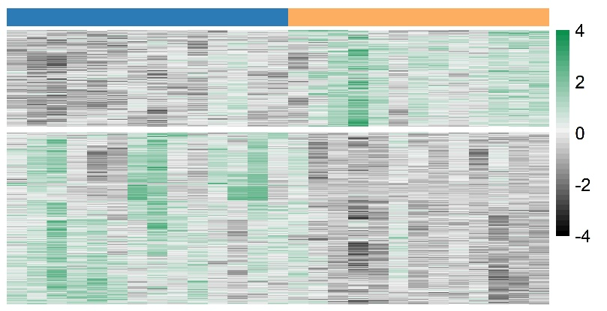
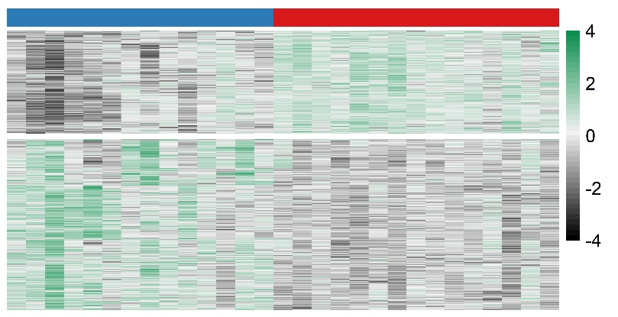
Z-score
Gene
Gene
Crab Individual
Ambient
Moderate OA
Severe OA

Slide 5
Module eigengene (mean ± SD)
pCO₂ treatment (µatm)

Slide 6
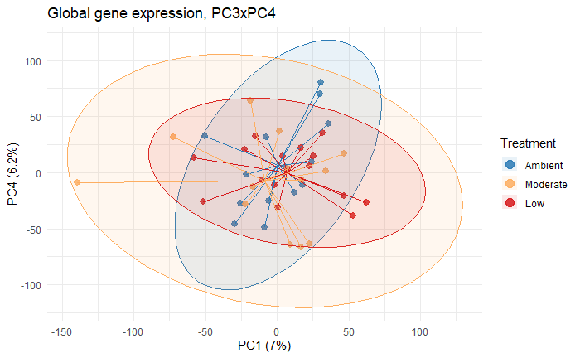
Ambient (8.0)
Moderate OA (7.8)
Severe OA (7.5)

Slide 7
